Slide 1
Architecture Design
Team Easytodo

Slide 2
Contents
Structural elements and their interfaces
Collaboration behavior among elements
The architectural style guide that guides this organization

Slide 3
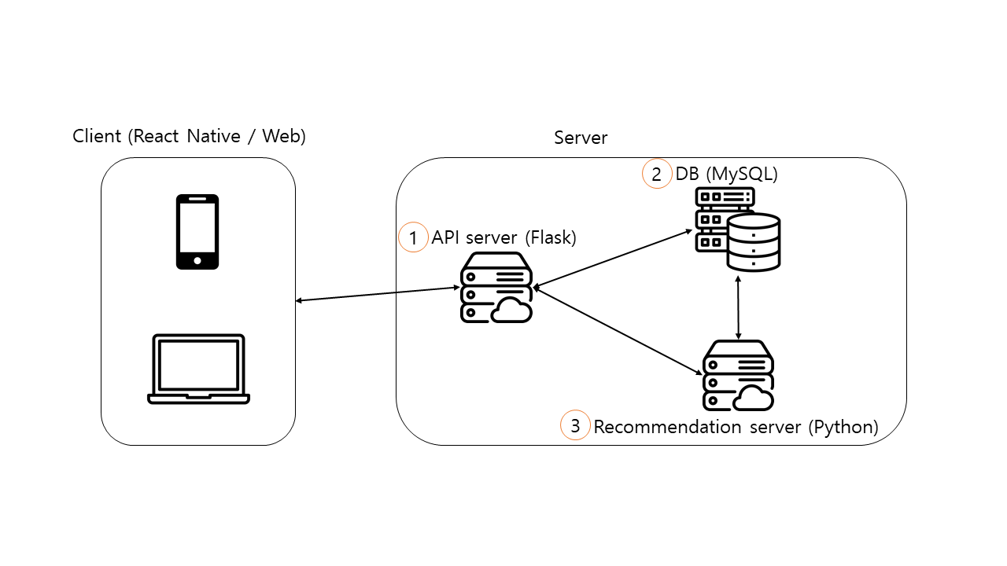
Structural elements and their interfaces

Slide 4
Structural elements and their interfaces
API server (Flask)
Input
Client (requests with REST API) -> API server (responds with JSON)
POST login, GET tododata, PUT tododata, GET recommendation, POST logout, DELETE account
Output
API server (requests with SQL query) -> DB (responds with data)
SELECT/INSERT/UPDATE
API server (requests with string through socket call) -> Recommendation server (responds with string data through socket)
Get recommendation

Slide 5
Structural elements and their interfaces
DB (MySQL)
Input
API server (requests with MySQL query) -> DB (responds with data)
SELECT/INSERT/UPDATE
Recommendation system (requests with SQL query) -> DB (responds with data)
SELECT

Slide 6
Structural elements and their interfaces
Recommendation server (Python)
Input
API server (requests with string through socket) -> Recommendation system (responds with string data through socket)
Get recommendation
Output
Recommendation system (requests with SQL query) -> DB (procedure call: SQL query -> data)
SELECT

Slide 7
Collaboration behavior among elements
Login procedure
Session for authentication
Data request/data edit/logout procedure => all API calls that need authentication
Recommendation request procedure

Slide 8
login procedure
client
API server
Google server
POST login
Google OAuth link
open the Google OAuth link and login with Google account
API server login callback link
open login callback link
request access token
access token
create session and sid
respond with sid

Slide 9
Session
uid (unique id of the user)
sid (unique session id)
lifetime (24 hours)
Session is created when login happens and there is no existing session for that user.
User can access personalized information by using the sid as an authentication.
Session expires after the lifetime and is removed.
Session expiration time is delayed if the sid is used through API calls.

Slide 10
data request/data edit/logout procedure
client
Google server
REST API call with cookies: sid=given_sid
verify sid
respond with result or 401 error if unverified

Slide 11
recommendation request procedure
client
API server
Recommendation server
DB
REST API call with cookies: sid=given_sid
verify sid
request recommendation for the user
request user data if necessary
respond with user data if requested
respond with result
respond with result

Slide 12
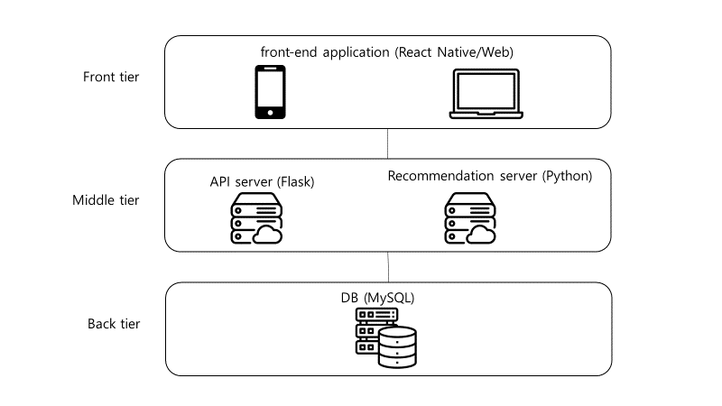
The architectural style guide that guides this organization
Layer architecture pattern is used.
High modularity due to information hiding
The communication overhead between and within the layers could slow down the software if there are too many layers.
Since we have only 3 layers and a high modularity can enhance the development speed, the layer pattern seems appropriate for our software.

